Slide 1
DRC Waiver Request
M15313

Slide 2
M2.DN.1

Slide 3
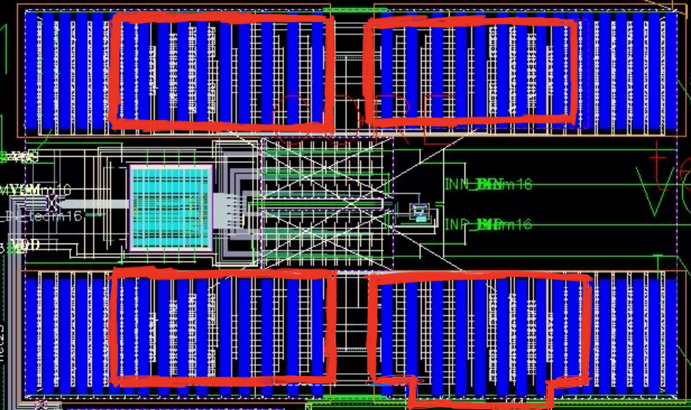
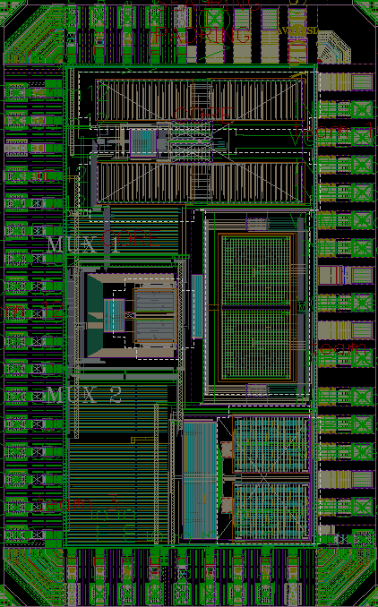
M2.DN.1 (1)
325 u
Error | Achieved Density (Mininum density inside red areas) | Required Density in 75um X 75um
M2.DN.1 | 0.4% | 10%
138 u
This is the Capacitance Array for one SAR ADC located on the top of the chip. The Cap array is very sensitive to the dummy fill which will worse the ADC’s performance. Dummy exclude layers are put around Cap array.

Slide 4
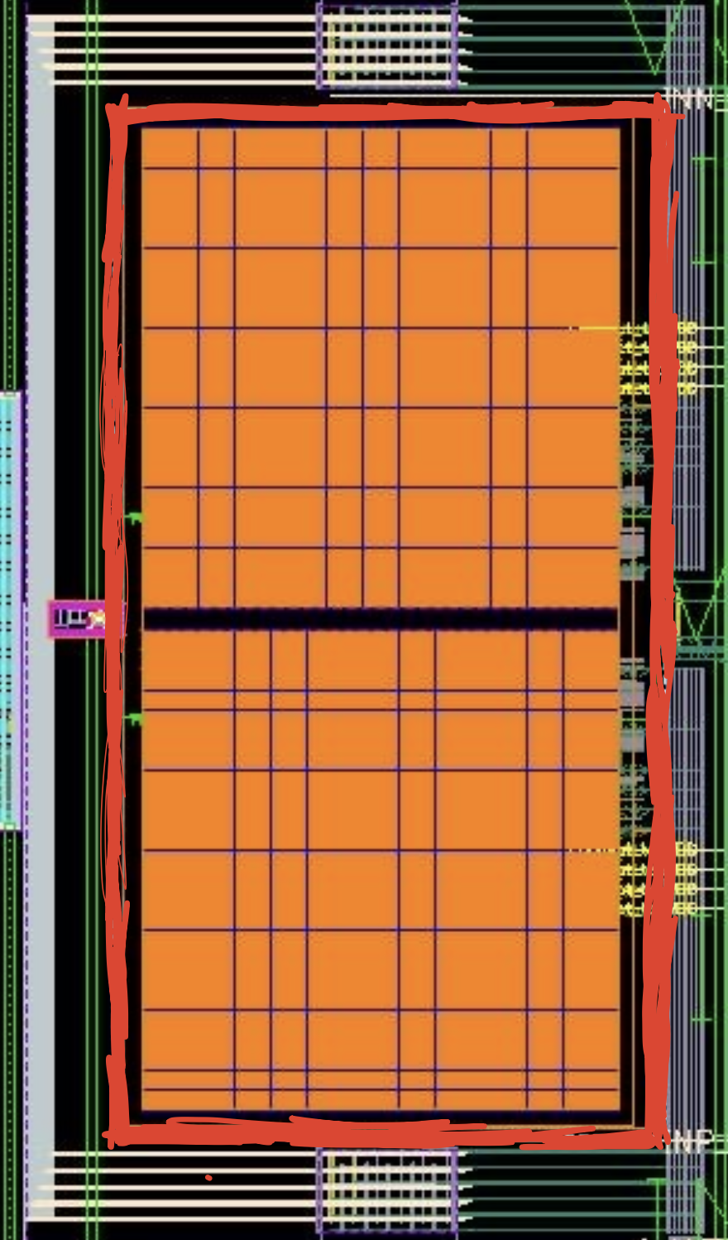
M2.DN.1 (2)
Error | Achieved Density inside Red area | Required Density in 75um X 75um
M2.DN.1 | 6.5% | 10%
This is the Capacitance Array for one SAR ADC located on the middle right of the chip. The Cap array is very sensitive to the dummy fill which will worse the ADC’s performance. Dummy exclude layers are put around Cap array.
500 u
260 u

Slide 5
M3.DN.1

Slide 6
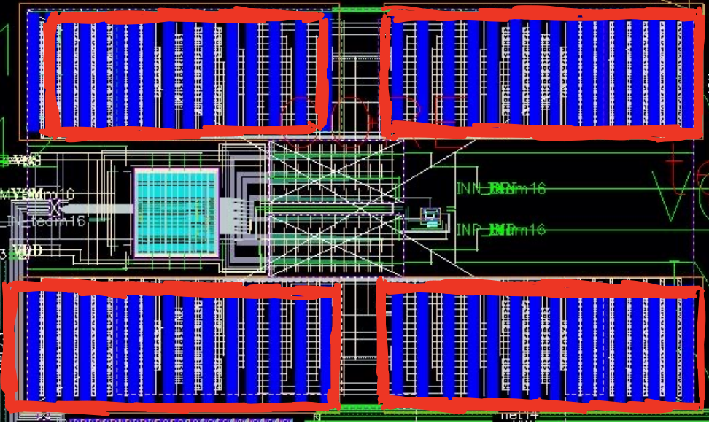
M3.DN.1 (1)
325 u
Error | Achieved Density (Mininum density inside red areas) | Required Density in 75um X 75um
M3.DN.1 | 0.4% | 10%
138 u
This is the Capacitance Array for one SAR ADC located on the top of the chip. The Cap array is very sensitive to the dummy fill which will worse the ADC’s performance. Dummy exclude layers are put around Cap array.

Slide 7
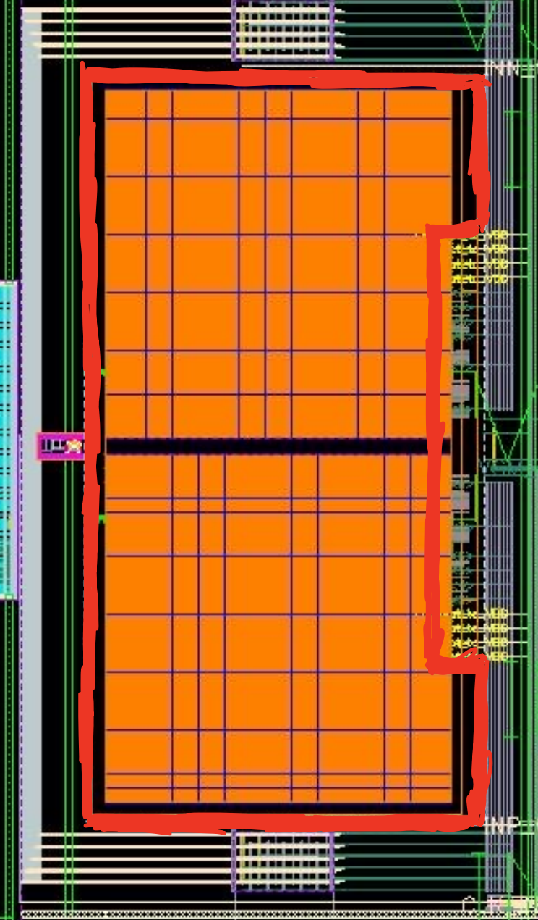
M3.DN.1 (2)
Error | Achieved Density inside Red area | Required Density in 75um X 75um
M3.DN.1 | 2.7% | 10%
This is the Capacitance Array for one SAR ADC located on the middle right of the chip. The Cap array is very sensitive to the dummy fill which will worse the ADC’s performance. Dummy exclude layers are put around Cap array.
500 u
260 u

Slide 8
M4.DN.1

Slide 9
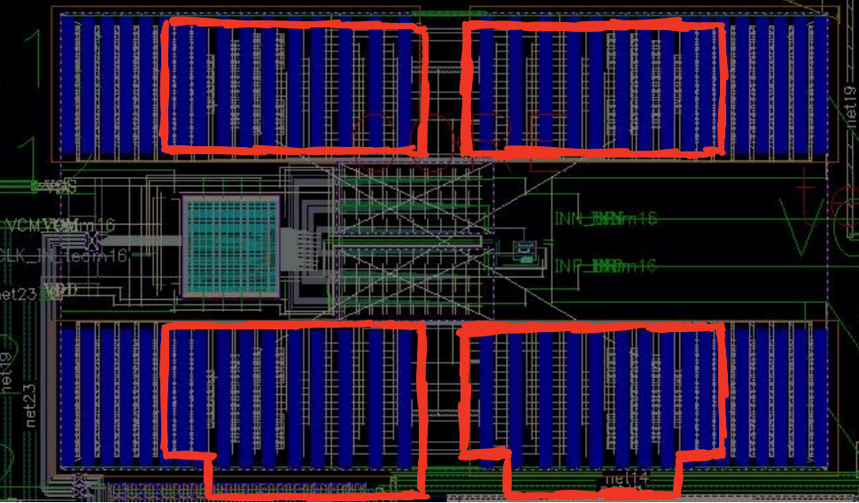
M4.DN.1 (1)
325 u
Error | Achieved Density (Mininum density inside Red areas) | Required Density in 75um X 75um
M4.DN.1 | 0.5% | 10%
138 u
This is the Capacitance Array for one SAR ADC located on the top of the chip. The Cap array is very sensitive to the dummy fill which will worse the ADC’s performance. Dummy exclude layers are put around Cap array.

Slide 10
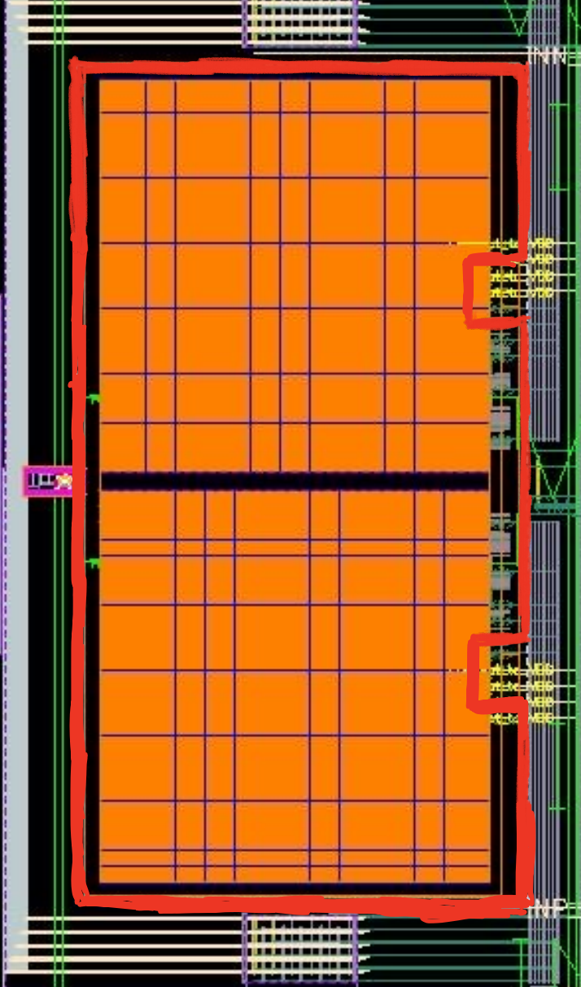
M4.DN.1 (2)
Error | Achieved Density inside Red area | Required Density in 75um X 75um
M4.DN.1 | 1.3% | 10%
This is the Capacitance Array for one SAR ADC located on the middle right of the chip. The Cap array is very sensitive to the dummy fill which will worse the ADC’s performance. Dummy exclude layers are put around Cap array.
500 u
260 u

Slide 11
M7.DN.1

Slide 12
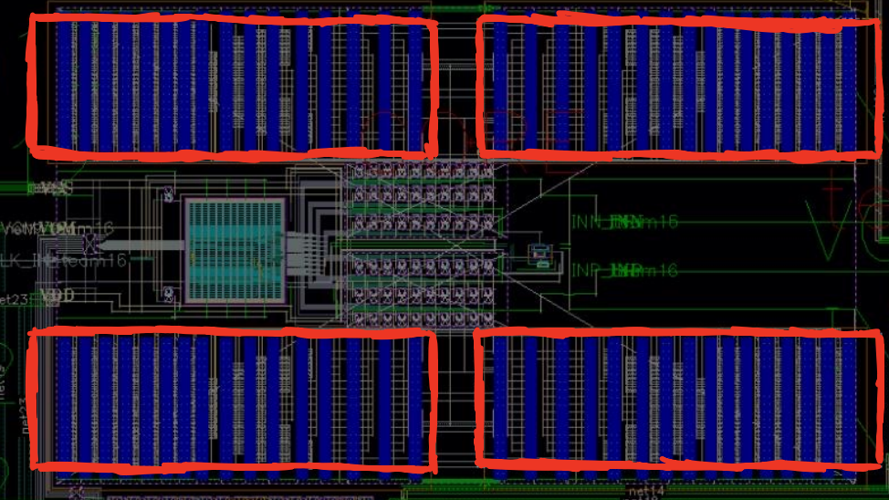
M7.DN.1 (1)
325 u
Error | Achieved Density (Mininum number inside Red areas) | Required Density in 75um X 75um
M7.DN.1 | 0.46% | 10%
138 u
This is the Capacitance Array for one SAR ADC located on the top of the chip. The Cap array is very sensitive to the dummy fill which will worse the ADC’s performance. Dummy exclude layers are put around Cap array.

Slide 13
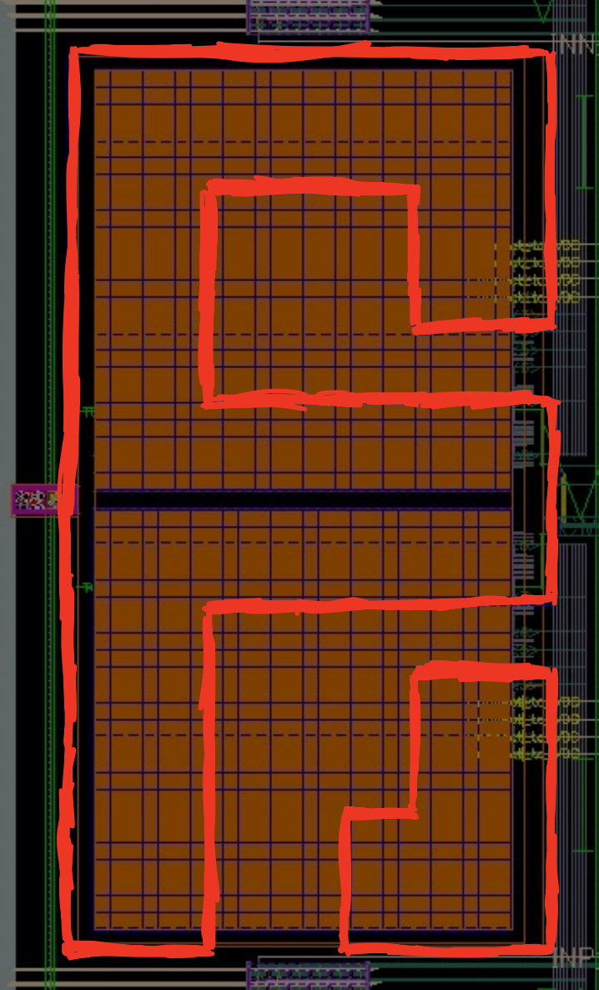
M7.DN.1 (2)
Error | Achieved Density (Mininum density inside Red areas) | Required Density in 75um X 75um
M7.DN.1 | 7.4% | 10%
This is the Capacitance Array for one SAR ADC located on the middle right of the chip. The Cap array is very sensitive to the dummy fill which will worse the ADC’s performance. Dummy exclude layers are put around Cap array.
500 u
260 u

Slide 14
M8.DN.1

Slide 15
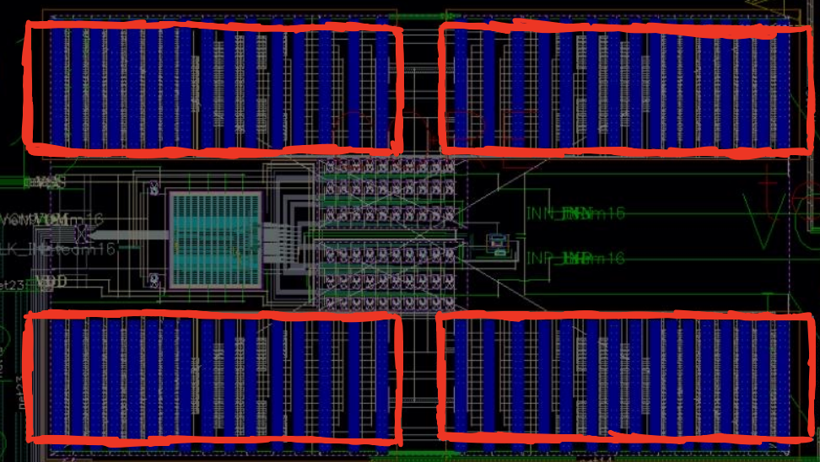
M8.DN.1 (1)
325 u
Error | Achieved Density (Mininum Density inside Red areas) | Required Density in 75um X 75um
M8.DN.1 | 0.4% | 20%
138 u
This is the Capacitance Array for one SAR ADC located on the top of the chip. The Cap array is very sensitive to the dummy fill which will worse the ADC’s performance. Dummy exclude layers are put around Cap array.

Slide 16
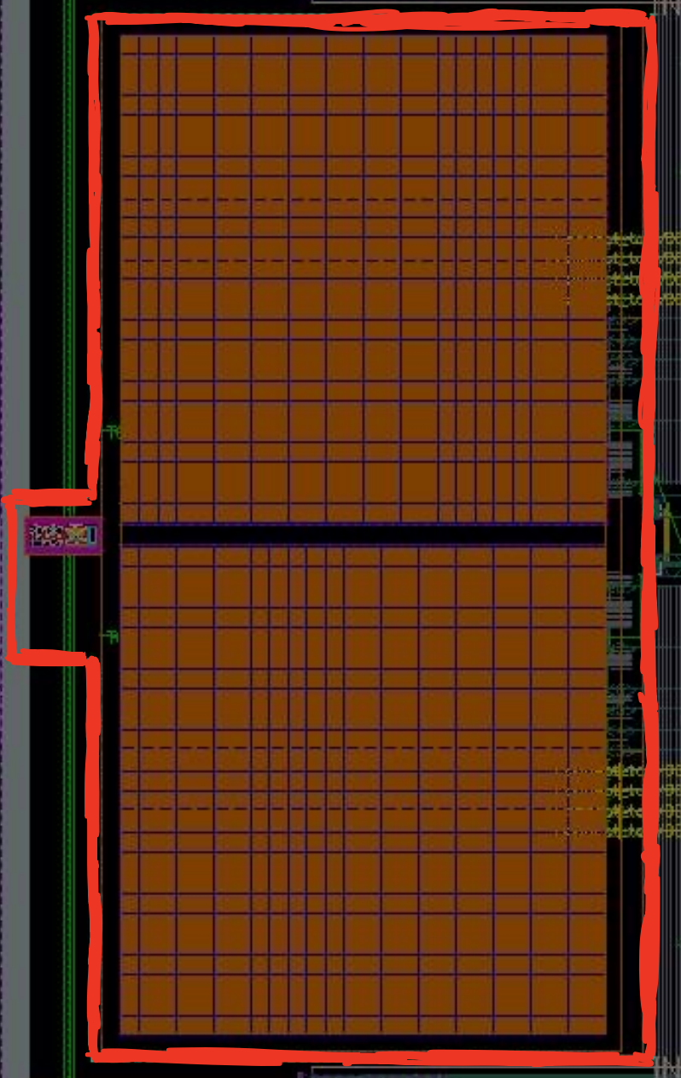
M8.DN.1 (2)
Error | Achieved Density inside Red area | Required Density in 75um X 75um
M8.DN.1 | 5.4% | 20%
This is the Capacitance Array for one SAR ADC located on the middle right of the chip. The Cap array is very sensitive to the dummy fill which will worse the ADC’s performance. Dummy exclude layers are put around Cap array.
500 u
260 u

Slide 17
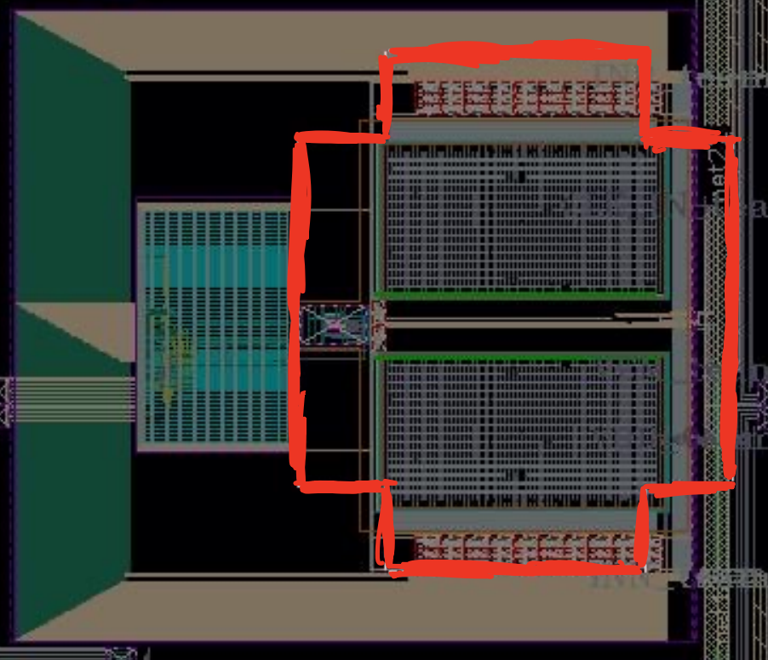
M8.DN.1 (3)
Error | Achieved Density inside Red area | Required Density in 75um X 75um
M8.DN.1 | 0% | 20%
This is the Capacitance Array for one SAR ADC located on the middle left of the chip. The Cap array is very sensitive to the dummy fill which will worse the ADC’s performance. Dummy exclude layers are put around Cap array.
180 u
154 u

Slide 18
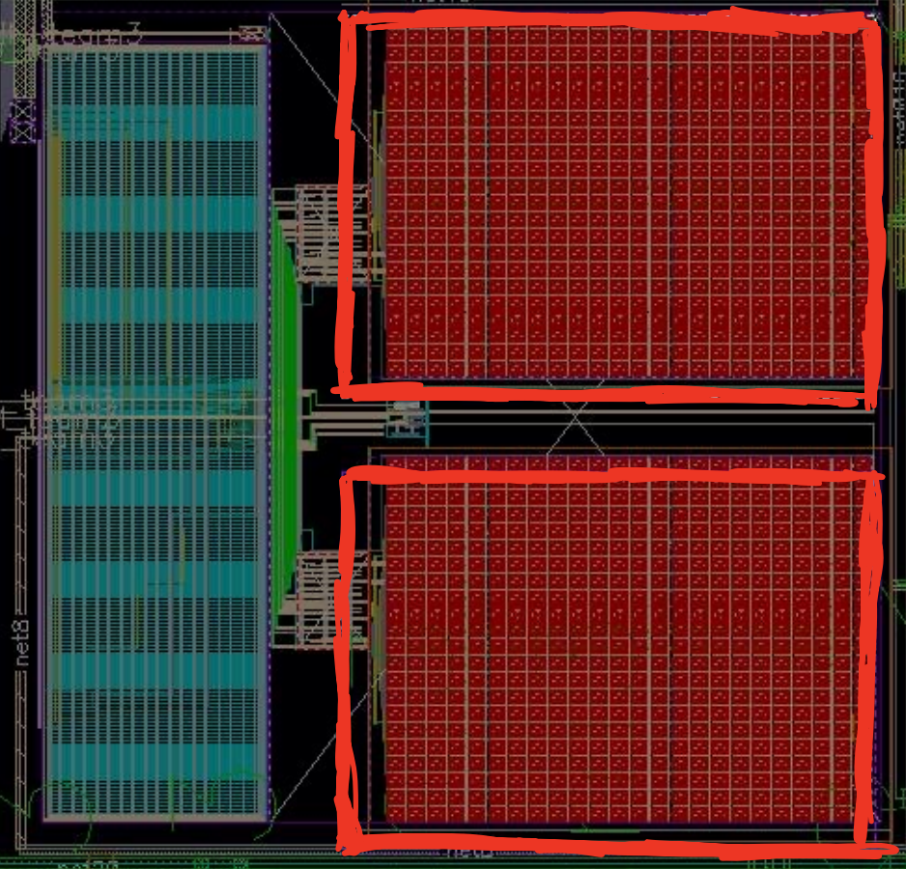
M8.DN.1 (4)
Error | Achieved Density (Mininum number inside Red areas) | Required Density in 75um X 75um
M8.DN.1 | 17% | 20%
This is the Capacitance Array for one SAR ADC located on the bottom of the chip. The Cap array is very sensitive to the dummy fill which will worse the ADC’s performance. Dummy exclude layers are put around Cap array.
424 u
264 u

Slide 19
M9.DN.2

Slide 20
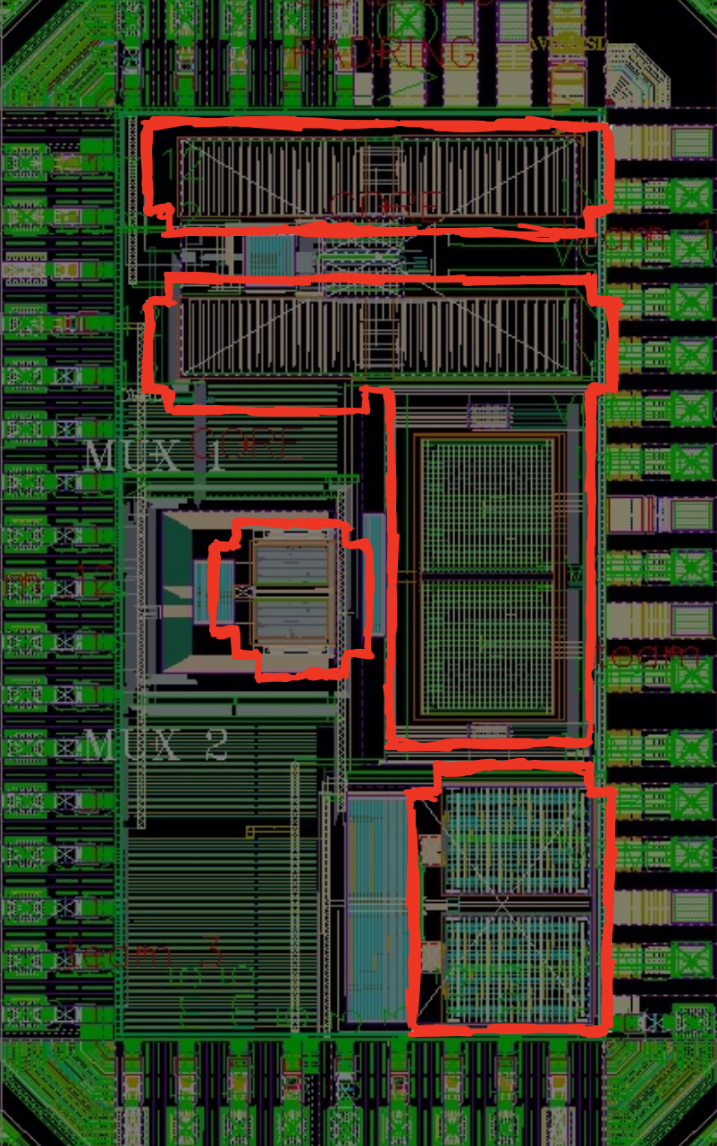
M9.DN.2
Error | Achieved Density (Mininum number inside Red areas) | Required Density in 75um X 75um
M9.DN.2 | 0% | 20%
This is the Capacitance Array for the four SAR ADCs The Cap array is very sensitive to the dummy fill which will worse the ADC’s performance. Dummy exclude layers are put around Cap array.

